Slide 1
ESS AGENT — BUSINESS IMPACT
Getting realized time-savings values
Guide to source, classify and define “real” time savings for topics resolved by Agents

Slide 2
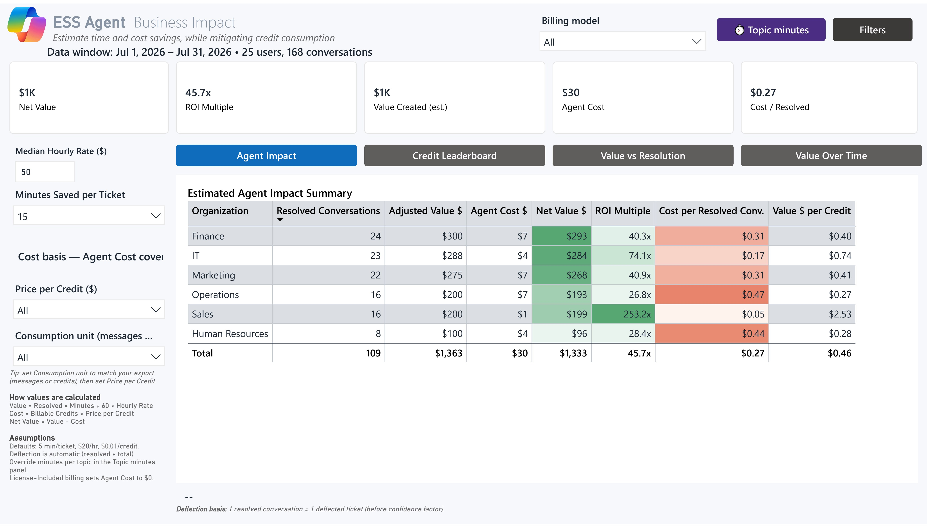
ESS Business Value Report estimates realized savings based on the time to resolve each topic
An example view. Whatever topics a tenant has, each one needs a minutes value, and Hours Saved and Value $ are derived from it.

Slide 3
Four steps turn a resolved topic into a minutes value
Core principle: Every topic that is resolved by the agent is a case avoided and thus human effort avoided
1
2
3
4
Take the topics
Take the resolved topic list and volumes from agent analytics
Source the records
Get last 2-3 months resolved tickets and closed cases from ITSM and HRSD owners
Classify
Map each topic to the real categories that handled it, and validate
Average and enter
Divide total work minutes by matched records, then enter the result

Slide 4
Not every topic has a ticket behind it, and that is expected
1
Topics that replaced a ticket
Password reset, benefits enrollment, payroll discrepancy. A record exists — source the work time and average it.
2
Topics that replaced a search
Policy lookups, office locations, org chart, acronym questions. No ticket was ever raised — the employee would have searched, asked a colleague, or given up.
3
Topics that replaced nothing
Greetings, “what can you do”, smalltalk. Enter zero. No human effort was ever going to be spent.
4
Pick one convention and hold it
Either enter a low informational value for search-replacement topics, or enter zero and treat the saving as unvalued upside. Both are defensible. Mixing them silently is not.

Slide 5
Key data sources and typical owners
Owner | What they hold | Ask them for | Typical platform
IT Service Desk Ops | Incident and request queues | Category list, resolved tickets, logged work time | ServiceNow, Jira SM, Zendesk, Freshservice
HR Shared Services | Employee case types and service catalog | Topic list, closed cases, case touch time | ServiceNow HRSD, Workday Help, Dayforce
HRIT or platform admin | Field configuration and export rights | Whether work time is captured at all, plus export access | Same platforms
Reporting or analytics lead | Report builder and scheduled exports | The extract itself, refreshed each quarter | Reporting layer of each platform
Ask for aggregated or de-identified rows. No employee-submitted content is needed at any point.

Slide 6
Every platform stores handle time in a different field
Platform | Records to pull | Category fields | Work-time field
ServiceNow ITSM | incident, sc_req_item | category, subcategory | time_worked, time_card
ServiceNow HRSD | HR cases, HR tasks | HR service, case category | case touch time
Workday Help | Help cases | case type, service category | solver activity time
Jira Service Mgmt | issues, requests | project, request type, label | worklogs, time spent
Zendesk | solved tickets | tags, form, type, group | time-tracking field
Freshservice | tickets, time entries | category, subcategory, item | time_entries
Dayforce | HR cases | topic, subtopic | none; Hours to Close is elapsed
Field names here are from each vendor's published documentation. Internal names might vary.

Slide 7
Key fields to request
FIELDS THE EXTRACT MUST CARRY
Data owner ask (ITSM or HR Service Delivery or Vendor teams)
Ticket or case ID
Category, subcategory, item
Created and resolved timestamps
Status or resolution code
Assignment group or service team
Logged work time
Channel, where captured
3 months of data is sufficient to get started on the journey.
If a row-level export is restricted, aggregated counts and average work time by category and month are enough to start.

Slide 8
When the platform does not capture work time, step down a tier and say so
1
Tier 1 — Sourced
Logged work or touch time taken straight from the record. Use when the field is populated and exportable.
2
Tier 2 — Measured sample
A time study: three to five handlers time twenty cases each in the mapped categories. Use when the field exists but is empty or unreliable.
3
Tier 3 — Estimated
A queue owner estimate, documented and signed. Use when there is no timing data and no capacity to run a study.
4
Tier 4 — Benchmark
A published benchmark for the category, used only when nothing internal exists. Any value below Tier 1 is reported as estimated, never as sourced — record the tier beside every value you enter.

Slide 9
Classify from the exported category list
1
Export the real values
Pull the live category, subcategory and topic list from the system. Vendor defaults are almost always customised.
2
Expect many categories to one topic
One agent topic usually maps to several ticket categories (e.g., vacation, PTO, time off, leave of absence (in service request) → PTO)
3
Read a sample before you trust it
Open twenty records per mapped category and confirm they are the same request the agent answered.
4
Have the queue owner sign the map
No averaging starts until the person who owns the queue agrees the mapping is right.

Slide 10
Group the tenant's topics into families, then map each family to its records
Topic family | Example topics | Where the records live | Owner
IT identity and access | Password reset, MFA, lockout, app access | ITSM plus IAM and Entra logs | Service Desk, IAM
IT endpoint | Device issue, VPN, hardware, peripherals | ITSM plus endpoint and asset tools | Endpoint Support
IT application support | App access, error, licence, configuration | ITSM plus app admin logs | Application Support, app owners
HR informational | PTO policy, holiday calendar, workplace policy | HR case and knowledge system | HR Shared Services, policy owners
Benefits administration | Eligibility, enrollment, life event, coverage | Benefits admin, HR case, vendor portal | Benefits COE
Payroll | Discrepancy, tax, direct deposit, paystub | Payroll platform plus HR case system | Payroll Operations
Families and example topics follow the Customer-Derived AHT Methodology. Sort the tenant's own agent topics into these families first.

Slide 11
Typical fields and their proxies for time savings
Metric | What it measures
Active handle time | Agent actively working the record, wrap-up included
Work or touch time | Sum of work entries across every handler
Resolution time | Created to resolved, elapsed
Cycle time | Request start to completion, end to end
AVERAGE HANDLE TIME
Σ chosen metric
÷ matched resolved records
Report the median alongside it. A wide gap means the category is mixing two kinds of work.
Take the median for the typical case and the average when planning capacity. Report the rejected metrics separately if the customer wants them.

Slide 12
Strip these records first, or the average will not survive review
Cancelled, duplicate, test
Records that never represented real handling work.
Major incident spikes
Mass contacts from one outage distort a topic average.
Already-automated completions
Self-service resets the customer ran before the agent arrived.
Hours to Close, full resolution time and SLA clocks are elapsed time, not handling work.
Using one of them in place of work time multiplies the value you enter several times over.

Slide 13
Two checks before the value leaves your hands
1
Minimum records
Below about thirty matched records, treat the result as indicative and label it estimated. The worked examples in this deck rest on 3,860 and 980 records — four tickets is an anecdote, not an average.
2
Plausibility band by topic family
Identity and access 4–10 min. Endpoint and hardware 10–30. Application access and support 8–20. HR informational and policy 5–15. Benefits administration 10–25. Payroll discrepancy 15–35.
3
What an out-of-band number usually means
A password reset averaging forty-five minutes is almost always elapsed time that slipped past the filter on the previous slide. Re-check the metric before you re-check the mapping.
4
How to use the bands
Ranges are orientation only. A defended number outside the band is fine; an undefended one inside it is not.

Slide 14
Password reset: 3,860 usable records and 24,704 logged minutes give 6.4
Topic family | MFA, password reset, logged out, login issues
Matched resolved tickets, 3 months | 4,120
Removed: cancelled, duplicate, outage | 260
Records used | 3,860
Total logged work minutes | 24,704
Value to enter | 6.4 min
6.4
minutes saved per ticket for this topic
Source: ServiceNow ITSM incident records with time_worked entries, matched to the categories in the map.
Illustrative figures showing the method. Replace every one with the customer's own extract.

Slide 15
PTO policy: definition does the work, and 980 usable cases give 8.5
Topic family | Leave, vacation, vacation balance, PTO, time off
Closed HR cases in mapped topics | 1,240
Removed: balance lookups, transactions | 260
Records used | 980
Total case work minutes | 8,330
Value to enter | 8.5 min
8.5
minutes saved per ticket for this topic
Multiple different requests arrive as PTO questions: policy answers, balance lookups and time-off transactions. Only the work the agent actually replaced belongs in the average.
Illustrative figures. Source: HR case records with logged touch time in the mapped topics.

Slide 16
Where the value goes: enter it once and the report does the rest
1
Start with the topics that carry the volume
Rank the tenant's resolved topics by conversation volume and source those first. The remainder use the global default.
2
Enter the value
Business Impact page, topic minutes panel. Select the topic and enter the minutes. Set greetings and smalltalk topics to zero.
3
The report derives the rest
Hours Saved equals resolved conversations times minutes divided by sixty. Value equals hours times the loaded hourly rate. Net Value subtracts agent cost.
4
Re-source on a rhythm
A sourced top fifteen normally covers the large majority of resolved conversations. Re-source quarterly, or after a process or knowledge change that alters how a category is handled.

Slide 17
APPENDIX
How to get the value, case by case
The labels to search, the records to pull, what to strip out, and the calculation for the most common IT and HR cases

Slide 18
IT cases: the labels to search and the calculation for each family
Case family | Labels to search | Records and fields | How to calculate the value
IT identity and access | Password reset, MFA, 2FA, account locked, access request, permissions | Tickets with time worked, reassignment count, application | Sum time worked per ticket, divide by distinct tickets
IT endpoint | Laptop request, hardware, OS, printer, peripheral, docking station, RMA | Tickets with asset ID, device model, vendor or RMA flag | Time entries per ticket. Exclude shipping and depot wait
IT collaboration | Email, mailbox, Outlook, Teams, calendar, SharePoint, OneDrive | Tickets with service or application, affected user count | Time worked per category. Exclude multi-user service incidents
IT application support | Software access, app error, configuration, licence request, integration | Tickets with application or CI, linked defect ID | Time worked by app support queue. Exclude engineering fix time
Labels are search seeds from the Customer Data Collection Guide. Validate each against the tenant's exported category list.

Slide 19
HR cases: the labels to search and the calculation for each family
Case family | Labels to search | Records and fields | How to calculate the value
HR informational | Policy question, handbook, PTO, vacation policy, time away, leave type | Cases with topic, service team, time worked where captured | Case time worked divided by resolved cases. Otherwise sample rep activity
Benefits administration | Benefits, eligibility, enrollment, life event, dependent, open enrollment | Cases with benefit type, vendor handoff, life-event flag | Case time worked. Where a vendor runs support use their AHT by inquiry type
Payroll | Pay issue, payslip, direct deposit, tax form, W-2, employment verification | Cases with pay period, vendor handoff, document status | Case touch time. Separate handling from document generation
Talent and performance | Performance review, goals, feedback, learning, mobility, manager support | Cases with process, requester role, workflow status | Case touch time for questions. Keep admin time separate from self-service
Labels are search seeds from the Customer Data Collection Guide. Validate each against the tenant's exported topic list.

Slide 20
Three IT cases worked end to end, from records to the value
Case | Pull and filter | Remove before averaging | The value
MFA reset | ServiceNow incident plus time_worked, and Entra MFA audit logs. Category contains MFA, authentication or multi-factor; state Resolved or Closed | Duplicate contacts, outage-driven contacts, knowledge-only hits, cancelled requests | Median of summed time_worked minutes per ticket. Report all resets and non-escalated resets separately
Password reset and lockout | ITSM ticket table plus time entries, and self-service reset logs. Labels include password reset or account lockout; resolved or closed | Automated self-service completions already deflected, duplicates, bulk outage contacts | Ticket work entries, never created-to-resolved elapsed. Publish mean and median by channel
Application access request | ITSM requests plus approval and app admin logs. Request type Application Access; status fulfilled or closed; exclude projects and changes | Denied or ineligible requests, duplicates, bulk onboarding batches | Worklog entries by assignee. Approval waiting time is not labour and stays out
Method templates from the Customer-Derived AHT Methodology. Field names vary by tenant.

Slide 21
Three HR cases worked end to end, from records to the value
Case | Pull and filter | Remove before averaging | The value
PTO policy | HR case and knowledge reports plus HRIS time-off logs. Topic PTO, vacation or leave policy; status Closed | Balance questions, time-off transactions, and country-specific or protected leave cases | HRSS work time on comparable cases. Closed minus submitted is service speed, not the value
Benefits eligibility | HRSD, Workday or Dayforce benefits cases plus vendor reports. Topic Benefits, subtopic Eligibility or Coverage; status Closed | Plan-change transactions needing a specialist, repeated open-enrollment questions | Median active work time. Where a vendor handles support use their AHT, and segment open enrollment from steady state
Payroll discrepancy | Payroll and HRSD cases plus payroll platform records. Topic Payroll, subtopic discrepancy, missing pay or tax; status Closed, pay period captured | Paystub access questions, duplicate contacts within one pay period | Payroll specialist touch time or case work time. Hours to Close is not the value. Use aggregate rows only
Method templates from the Customer-Derived AHT Methodology. Payroll data is sensitive; request aggregate rows only.

